Slide 1
ARCHITECTURE

Slide 2
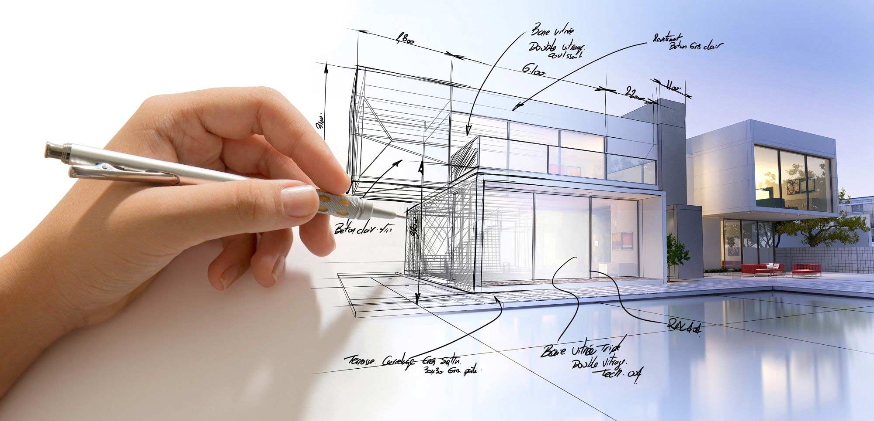
Architecture Design
Schematic Design
Design Development
Contract Documents
Bidding
Contrast Administration

Slide 3
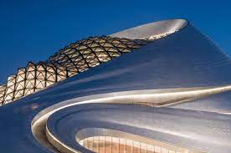
Opera House….
By Ma Yansong
MAD Architects…

Slide 4
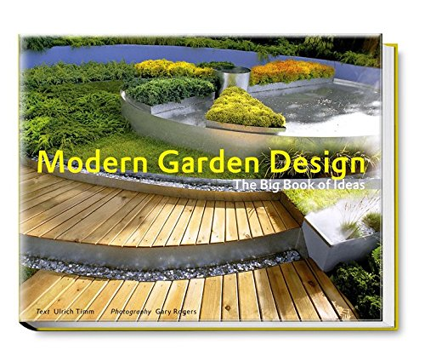
Modern Garden Design

Slide 5
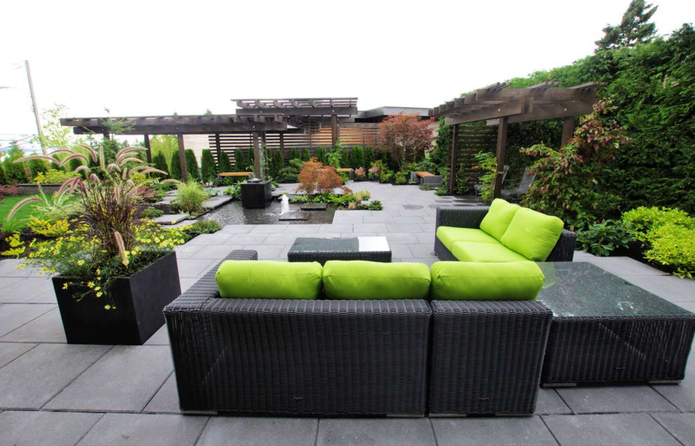
Imagination Power
Creative Thinking
Horticulture

Slide 6

Architect Religious
Temples
Christian Church
Islamic Masjid
Taj Mahal
Charminar

Slide 7
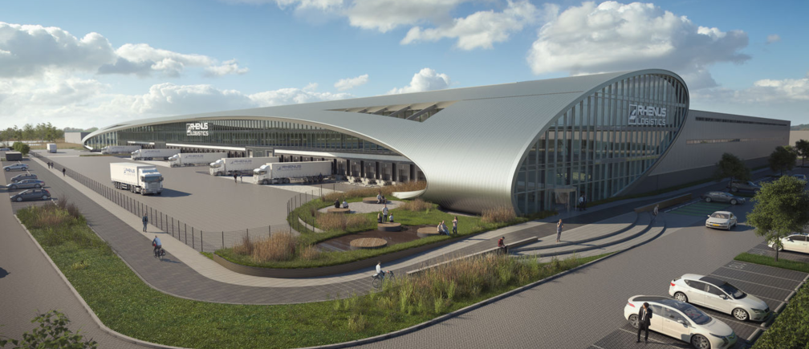
Architectural Industries
Factories
Power Plants
Water Towers

Slide 8
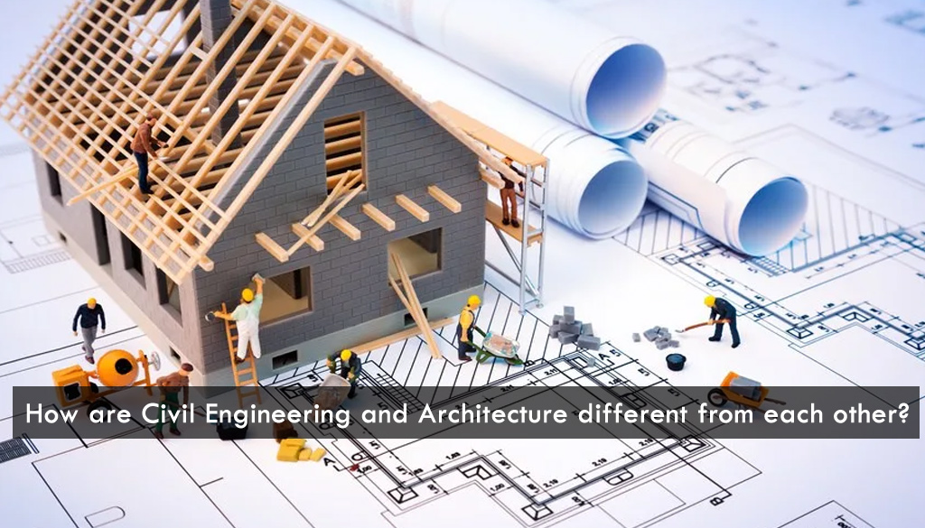
Architecture Engineering
Analysis
Planning
Construction

Slide 9
THANK YOU

